Slide 1


Ethical Use of Artificial Intelligence in Surveillance and Military Technology
This presentation explores the complex ethical considerations surrounding the application of artificial intelligence in surveillance and military contexts, examining key issues, potential benefits, and risks.
by binoy sarker

Slide 2

Overview of AI in Surveillance and Military Applications
Surveillance Applications
Facial recognition systems
Behavior analysis algorithms
Predictive policing tools
Military Applications
Autonomous weapons systems
Battlefield analysis and decision support
Cybersecurity and threat detection

Slide 3




Potential Benefits of AI in These Domains
Enhanced Security
AI can improve threat detection and response times, potentially saving lives and preventing attacks.
Increased Efficiency
Automation of routine tasks allows human resources to focus on more complex decision-making.
Improved Accuracy
AI systems can process vast amounts of data quickly, potentially reducing human error in critical situations.

Slide 4








Ethical Concerns and Risks
Privacy Violations
Algorithmic Bias
Widespread AI surveillance could lead to unprecedented invasions of personal privacy.
AI systems may perpetuate or amplify existing societal biases, leading to unfair targeting or discrimination.
Autonomous Weapons
Lack of Transparency
The development of AI-powered weapons raises concerns about accountability and the potential for uncontrolled escalation.
The "black box" nature of some AI algorithms makes it difficult to understand or challenge their decisions.

Slide 5
Legal and Regulatory Challenges
Current Regulatory Landscape
Proposed Solutions
Varying international laws and standards
Development of AI-specific regulations
Gaps in existing legislation regarding AI
International agreements on AI use in military contexts
Challenges in defining liability for AI actions
Mandatory ethical reviews for AI surveillance systems

Slide 6
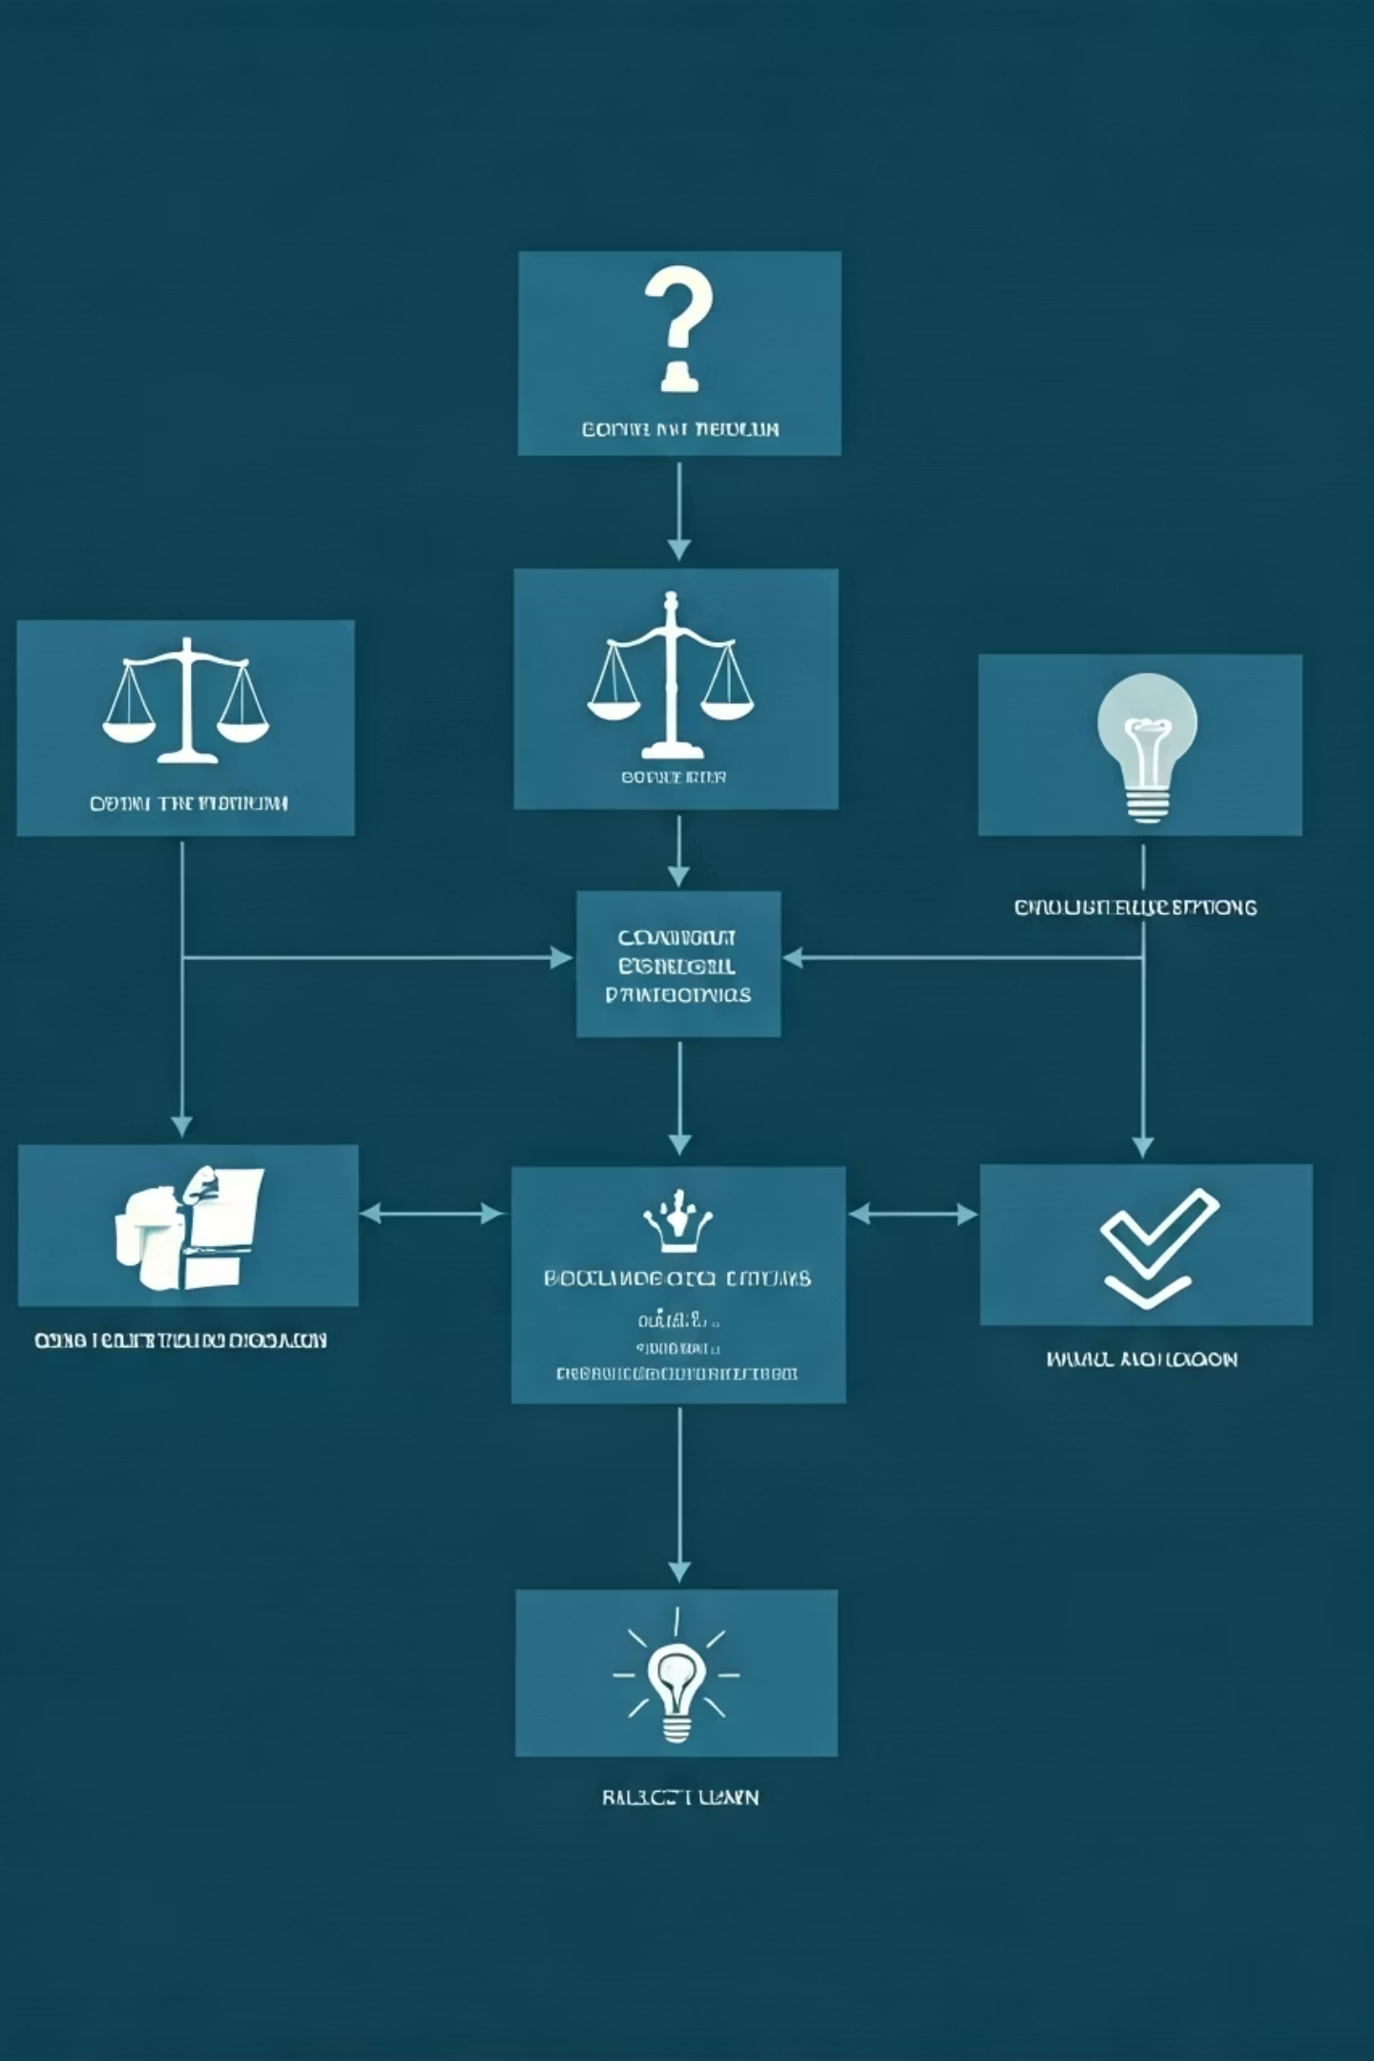
Ethical Frameworks for AI in Surveillance and Military Use
Transparency
Ensuring AI systems are explainable and their decision-making processes are open to scrutiny.
Accountability
Establishing clear lines of responsibility for AI-driven decisions and actions.
Fairness
Implementing safeguards against bias and ensuring equitable treatment across all demographics.
Human Oversight
Maintaining meaningful human control over critical AI systems, especially in military applications.

Slide 7
Case Studies and Real-World Examples
This section would typically include specific examples from academic sources. In their absence, we can note that case studies might cover:
Implementation of facial recognition in public spaces
Use of predictive policing algorithms and their impacts
Deployment of AI in conflict zones for reconnaissance or decision support
Ethical challenges faced in real-world applications of these technologies

Slide 8





Future Directions and Recommendations
Continued Research
Invest in ongoing studies on the ethical implications of AI in these domains
Policy Development
Create comprehensive, adaptable policies to guide ethical AI use
Public Engagement
Educate and involve the public in discussions on AI ethics
International Cooperation
Foster global agreements on ethical standards for AI in surveillance and military applications

